Slide 1
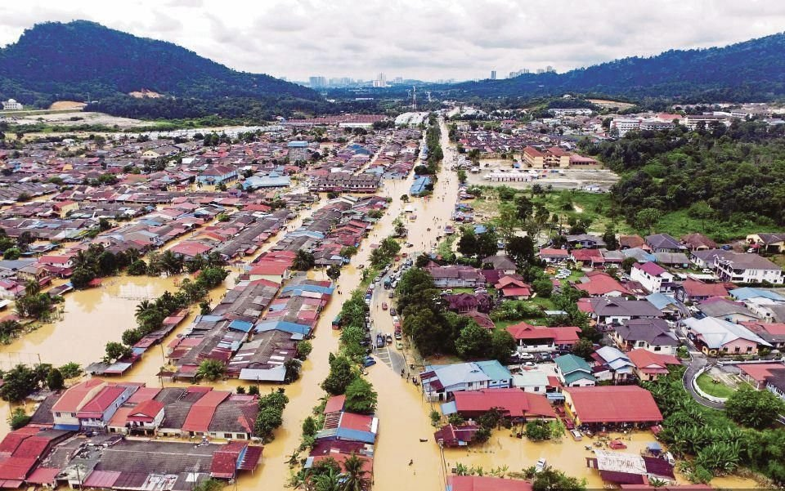


SESI PEMBENTANGAN 1
PENGENALAN KEPADA PENGURUSAN DAN PENGURANGAN RISIKO BENCANA KOMUNITI
MAJLIS PELANCARAN PASUKAN TINDAKAN KECEMASAN KOMUNITI (CERT) DAERAH KLANG
08 OKTOBER 2022
Kolaborasi Bersama:

Slide 2



PENGENALAN KEPADA PENGURUSAN DAN PENGURANGAN RISIKO BENCANA KOMUNITI
MAJLIS PELANCARAN PASUKAN TINDAKAN KECEMASAN (CERT)
DAERAH KLANG
08 OKTOBER 2022
Kapt. (PA) Maharris Bin Manan
Pegawai Peratahanan Awam Daerah
Pejabat APM Daerah Klang
139 Jalan Raya Barat
41000 Klang
Selangor Darul Ehsan
MALAYSIA CIVIL DEFENCE FORCE
PRIME MINISTER’S DEPARTMENT

Slide 3

KANDUNGAN
Bencana
Peranan Komuniti Dalam Pengurangan Risiko Bencana (DRR)
Peranan Komuniti Dalam Pengurusan Risiko Bencana (DRM)
Bagaimana Memulakannya diperingkat Komuniti

Slide 4
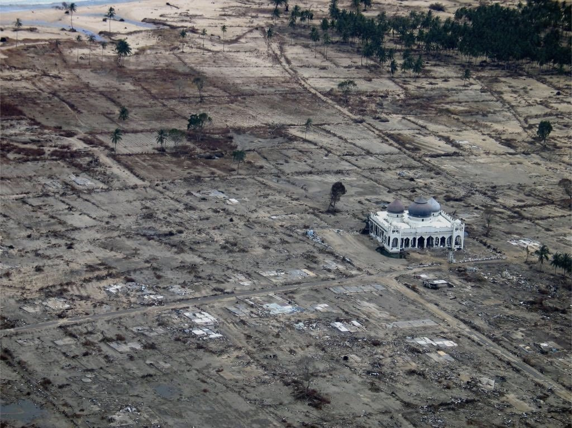


Impak bencana merupakan suatu keadaan yang terjadi seakan insiden serangan hendap dan ianya berlaku secara mengejut.
Keadaan bencana akan mengakibatkan situasi kucar kacir dengan hanya dalam beberapa saat sahaja selepas bencana berlaku.
Semua orang berlari keluar, tetapi para penyelamat berlari masuk ke kawasan bencana.
panik
kucar kacir
Notes:
the disaster risk area in the archipelago area in Peninsular Malaysia, indicated that 44.38% of Peninsular Malaysia was vulnerable area to tsunami, flood and landslide, while the remaining areas are in safe condition from natural disaster.
This shows that almost half the Peninsular Malaysia was exposed to natural disaster risk and requires comprehensive action in addressing the situation.
As well as the enhancement of efforts towards adapting disaster risk reduction approaches and mitigation efforts to enable local communities to cope with the many types of natural disasters they face, can be observed from various sites, ongoing and prospective developments effort globally as well as local government initiatives on DRR.
Among this gap is lack of study for identifying influential factors for community resilient.
With lack of input and information on local community resilient and their capability to raise above adversity, the ‘build back better’ concepts or post disaster and recovery process will take longer. As well as it makes it difficult for local communities to resilient as a whole.
[CLICK] Review of literature also indicated a research gap which highlighted in The National Disaster Management Policy and Mechanism for National Disaster and Relief Management is based on National Security Council (NSC) Directive No. 20 with emphasis on the implementation of operations before, during and after the disaster.
As well as outlining the operational directives or guidelines, but the mitigation and preparedness elements are also taken into account to ensure the community are always resilient to the disaster.
[CLICK] Therefore, a comprehensive research on resilient community is needed to fill the gap as mentioned by the National Security Council (NSC) Directive No. 20 hence providing crucial inputs on the current trend on community resilient.
From this research point of view, works that have been carried out by the NADMA Malaysia starting 2015, mostly focusing on promoting responses phase and hard-measures mitigation activity (top-down approach), rather than the soft-measures activity on DRR (bottom-up approach).
This gap is a strong justification for this research to be carried out to ensure the involvement of every level of stakeholders in disaster management were interconnected. A specific and comprehensive research should foster the understanding of resilient community covered all context.

Slide 5
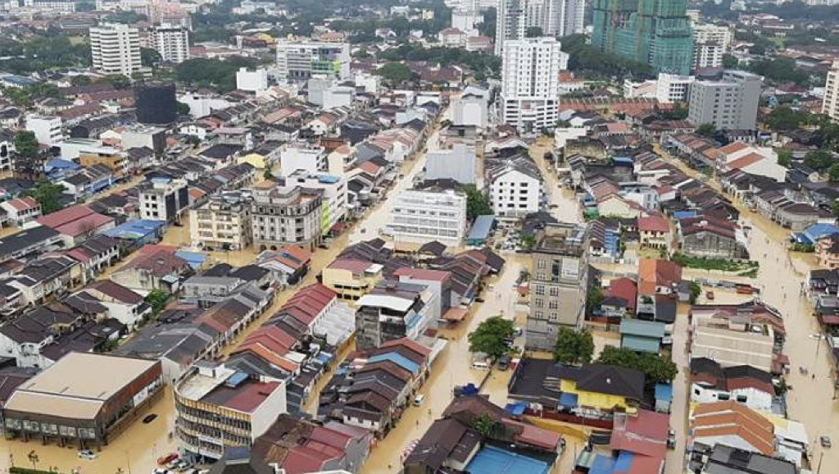
Kejadian bencana memerlukan pengendalian (pengurusan) yang melibatkan sumber, peralatan, kekerapan dan tenaga manusia yang ekstensif daripada banyak agensi serta penyelarasan yang berkesan, dan mungkin memerlukan proses yang kompleks dan berjangkamasa panjang.
Bencana Alam – Adakah kita bersedia?
Notes:
the disaster risk area in the archipelago area in Peninsular Malaysia, indicated that 44.38% of Peninsular Malaysia was vulnerable area to tsunami, flood and landslide, while the remaining areas are in safe condition from natural disaster.
This shows that almost half the Peninsular Malaysia was exposed to natural disaster risk and requires comprehensive action in addressing the situation.
As well as the enhancement of efforts towards adapting disaster risk reduction approaches and mitigation efforts to enable local communities to cope with the many types of natural disasters they face, can be observed from various sites, ongoing and prospective developments effort globally as well as local government initiatives on DRR.
Among this gap is lack of study for identifying influential factors for community resilient.
With lack of input and information on local community resilient and their capability to raise above adversity, the ‘build back better’ concepts or post disaster and recovery process will take longer. As well as it makes it difficult for local communities to resilient as a whole.
[CLICK] Review of literature also indicated a research gap which highlighted in The National Disaster Management Policy and Mechanism for National Disaster and Relief Management is based on National Security Council (NSC) Directive No. 20 with emphasis on the implementation of operations before, during and after the disaster.
As well as outlining the operational directives or guidelines, but the mitigation and preparedness elements are also taken into account to ensure the community are always resilient to the disaster.
[CLICK] Therefore, a comprehensive research on resilient community is needed to fill the gap as mentioned by the National Security Council (NSC) Directive No. 20 hence providing crucial inputs on the current trend on community resilient.
From this research point of view, works that have been carried out by the NADMA Malaysia starting 2015, mostly focusing on promoting responses phase and hard-measures mitigation activity (top-down approach), rather than the soft-measures activity on DRR (bottom-up approach).
This gap is a strong justification for this research to be carried out to ensure the involvement of every level of stakeholders in disaster management were interconnected. A specific and comprehensive research should foster the understanding of resilient community covered all context.

Slide 6
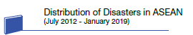
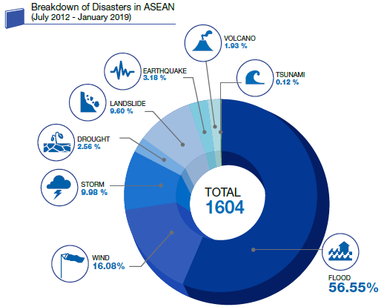
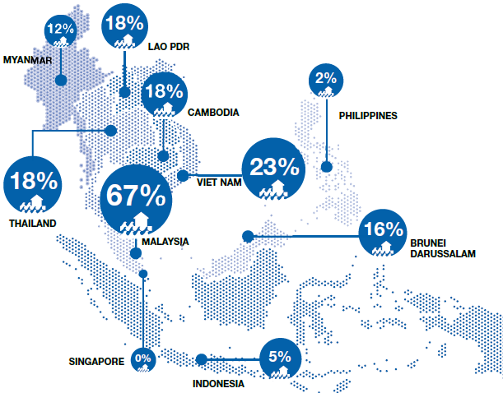
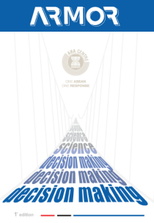
Bencana Alam
Negara-Negara ASEAN
Peratusan Kejadian Bencana di Negara-Negara ASEAN (Julai 2012 – Januari 2019)
Peratusan Penduduk Yang Terdedah Kepada Bencana Banjir (Julai 2012 – Januari 2019)
AHA Centre (2019) ASEAN Risk Monitor and Disaster Management Review 1st Edition
Notes:
the disaster risk area in the archipelago area in Peninsular Malaysia, indicated that 44.38% of Peninsular Malaysia was vulnerable area to tsunami, flood and landslide, while the remaining areas are in safe condition from natural disaster.
This shows that almost half the Peninsular Malaysia was exposed to natural disaster risk and requires comprehensive action in addressing the situation.
As well as the enhancement of efforts towards adapting disaster risk reduction approaches and mitigation efforts to enable local communities to cope with the many types of natural disasters they face, can be observed from various sites, ongoing and prospective developments effort globally as well as local government initiatives on DRR.
Among this gap is lack of study for identifying influential factors for community resilient.
With lack of input and information on local community resilient and their capability to raise above adversity, the ‘build back better’ concepts or post disaster and recovery process will take longer. As well as it makes it difficult for local communities to resilient as a whole.
[CLICK] Review of literature also indicated a research gap which highlighted in The National Disaster Management Policy and Mechanism for National Disaster and Relief Management is based on National Security Council (NSC) Directive No. 20 with emphasis on the implementation of operations before, during and after the disaster.
As well as outlining the operational directives or guidelines, but the mitigation and preparedness elements are also taken into account to ensure the community are always resilient to the disaster.
[CLICK] Therefore, a comprehensive research on resilient community is needed to fill the gap as mentioned by the National Security Council (NSC) Directive No. 20 hence providing crucial inputs on the current trend on community resilient.
From this research point of view, works that have been carried out by the NADMA Malaysia starting 2015, mostly focusing on promoting responses phase and hard-measures mitigation activity (top-down approach), rather than the soft-measures activity on DRR (bottom-up approach).
This gap is a strong justification for this research to be carried out to ensure the involvement of every level of stakeholders in disaster management were interconnected. A specific and comprehensive research should foster the understanding of resilient community covered all context.

Slide 7
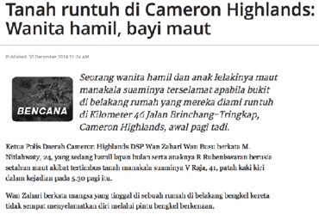
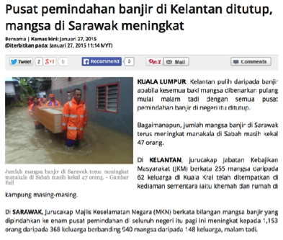
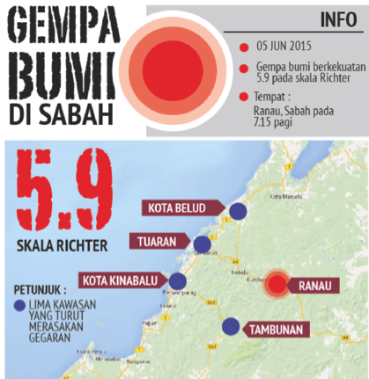
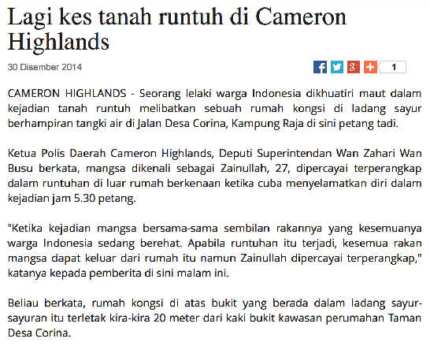
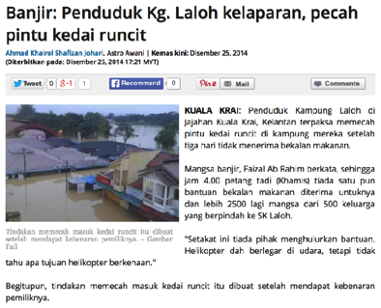
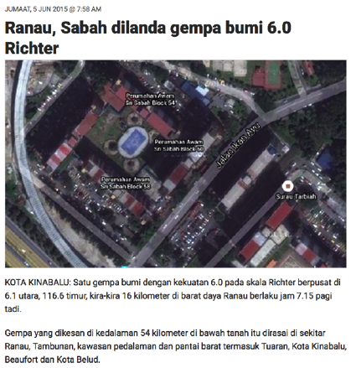
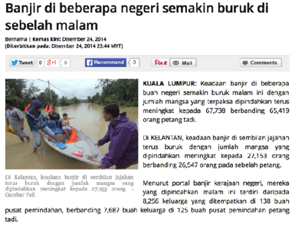
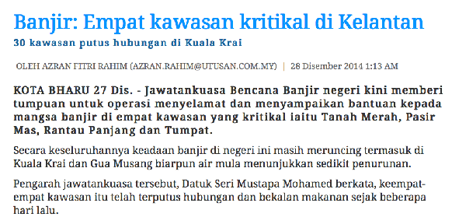
Bencana Alam
Dalam Negara
Notes:
the disaster risk area in the archipelago area in Peninsular Malaysia, indicated that 44.38% of Peninsular Malaysia was vulnerable area to tsunami, flood and landslide, while the remaining areas are in safe condition from natural disaster.
This shows that almost half the Peninsular Malaysia was exposed to natural disaster risk and requires comprehensive action in addressing the situation.
As well as the enhancement of efforts towards adapting disaster risk reduction approaches and mitigation efforts to enable local communities to cope with the many types of natural disasters they face, can be observed from various sites, ongoing and prospective developments effort globally as well as local government initiatives on DRR.
Among this gap is lack of study for identifying influential factors for community resilient.
With lack of input and information on local community resilient and their capability to raise above adversity, the ‘build back better’ concepts or post disaster and recovery process will take longer. As well as it makes it difficult for local communities to resilient as a whole.
[CLICK] Review of literature also indicated a research gap which highlighted in The National Disaster Management Policy and Mechanism for National Disaster and Relief Management is based on National Security Council (NSC) Directive No. 20 with emphasis on the implementation of operations before, during and after the disaster.
As well as outlining the operational directives or guidelines, but the mitigation and preparedness elements are also taken into account to ensure the community are always resilient to the disaster.
[CLICK] Therefore, a comprehensive research on resilient community is needed to fill the gap as mentioned by the National Security Council (NSC) Directive No. 20 hence providing crucial inputs on the current trend on community resilient.
From this research point of view, works that have been carried out by the NADMA Malaysia starting 2015, mostly focusing on promoting responses phase and hard-measures mitigation activity (top-down approach), rather than the soft-measures activity on DRR (bottom-up approach).
This gap is a strong justification for this research to be carried out to ensure the involvement of every level of stakeholders in disaster management were interconnected. A specific and comprehensive research should foster the understanding of resilient community covered all context.

Slide 8
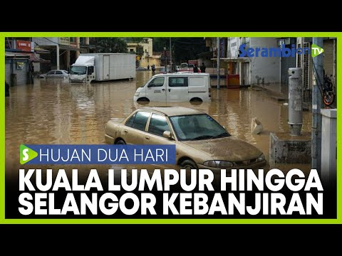
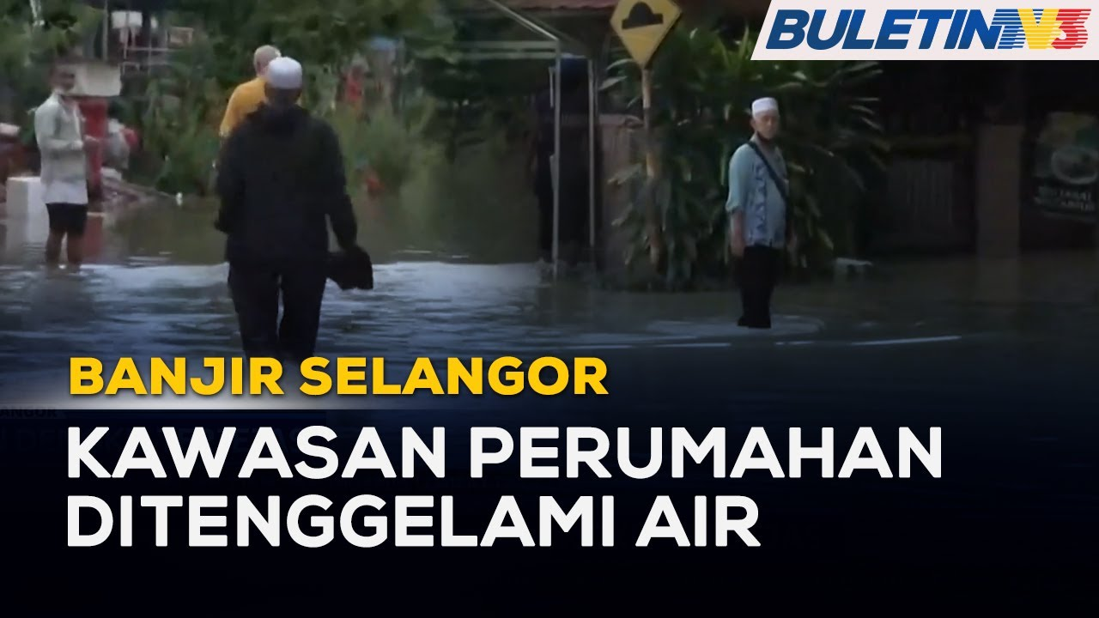
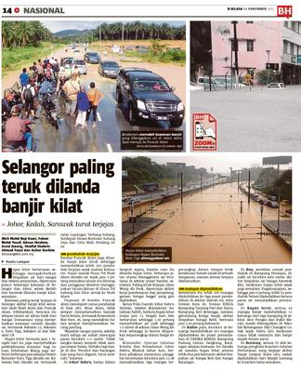
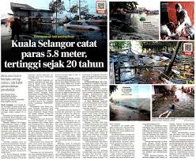
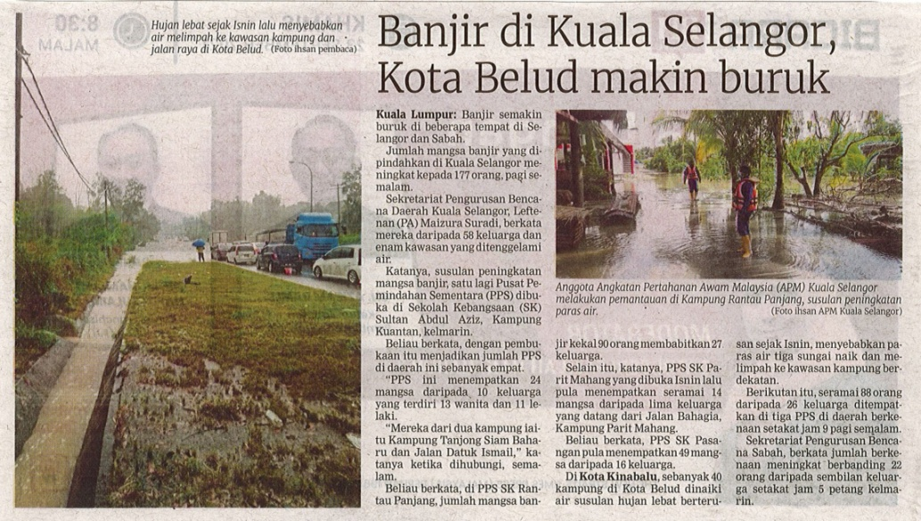
Berita Selangor

Slide 9
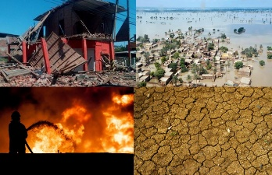
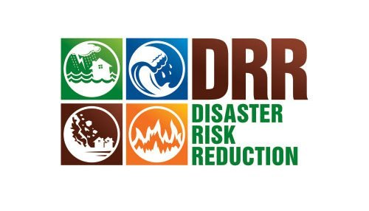


Peranan Komuniti Dalam Pengurangan Risiko Bencana
Disaster Risk Reduction (DRR)
Tiada kerajaan di dunia ini yang dapat menjamin sepenuhnya keselamatan rakyat / komuniti mereka apabila berlakunya BENCANA.
Oleh kerana itu, komuniti perlu mempunyai kemampuan dan harus DIPERSIAPKAN untuk mengurangkan faktor keterancaman akibat bencana.
Pengalaman
Pengetahuan
Sumber Daya
Kaedah
Peralatan
Masa
Sumber: UNISDR (2004) Living With Risk: A Global Review of Disaster Reduction Initiatives
Notes:
the disaster risk area in the archipelago area in Peninsular Malaysia, indicated that 44.38% of Peninsular Malaysia was vulnerable area to tsunami, flood and landslide, while the remaining areas are in safe condition from natural disaster.
This shows that almost half the Peninsular Malaysia was exposed to natural disaster risk and requires comprehensive action in addressing the situation.
As well as the enhancement of efforts towards adapting disaster risk reduction approaches and mitigation efforts to enable local communities to cope with the many types of natural disasters they face, can be observed from various sites, ongoing and prospective developments effort globally as well as local government initiatives on DRR.
Among this gap is lack of study for identifying influential factors for community resilient.
With lack of input and information on local community resilient and their capability to raise above adversity, the ‘build back better’ concepts or post disaster and recovery process will take longer. As well as it makes it difficult for local communities to resilient as a whole.
[CLICK] Review of literature also indicated a research gap which highlighted in The National Disaster Management Policy and Mechanism for National Disaster and Relief Management is based on National Security Council (NSC) Directive No. 20 with emphasis on the implementation of operations before, during and after the disaster.
As well as outlining the operational directives or guidelines, but the mitigation and preparedness elements are also taken into account to ensure the community are always resilient to the disaster.
[CLICK] Therefore, a comprehensive research on resilient community is needed to fill the gap as mentioned by the National Security Council (NSC) Directive No. 20 hence providing crucial inputs on the current trend on community resilient.
From this research point of view, works that have been carried out by the NADMA Malaysia starting 2015, mostly focusing on promoting responses phase and hard-measures mitigation activity (top-down approach), rather than the soft-measures activity on DRR (bottom-up approach).
This gap is a strong justification for this research to be carried out to ensure the involvement of every level of stakeholders in disaster management were interconnected. A specific and comprehensive research should foster the understanding of resilient community covered all context.

Slide 10
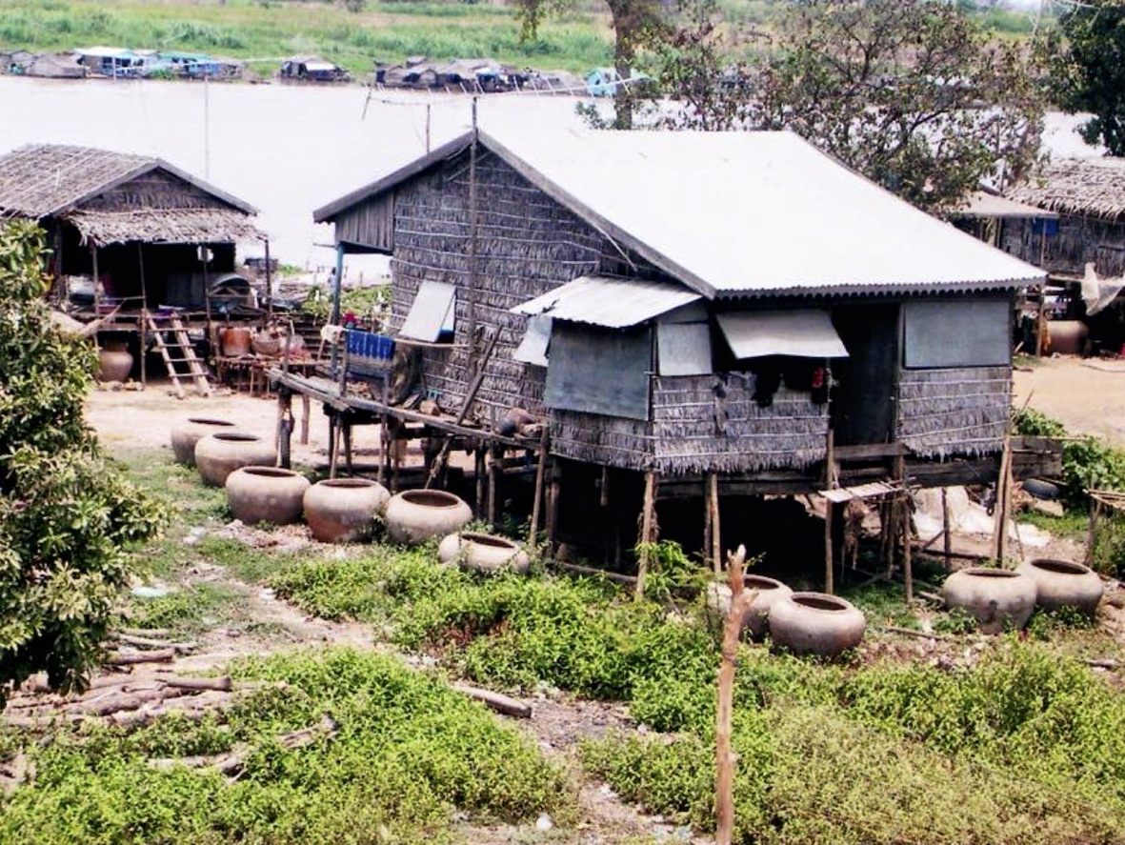
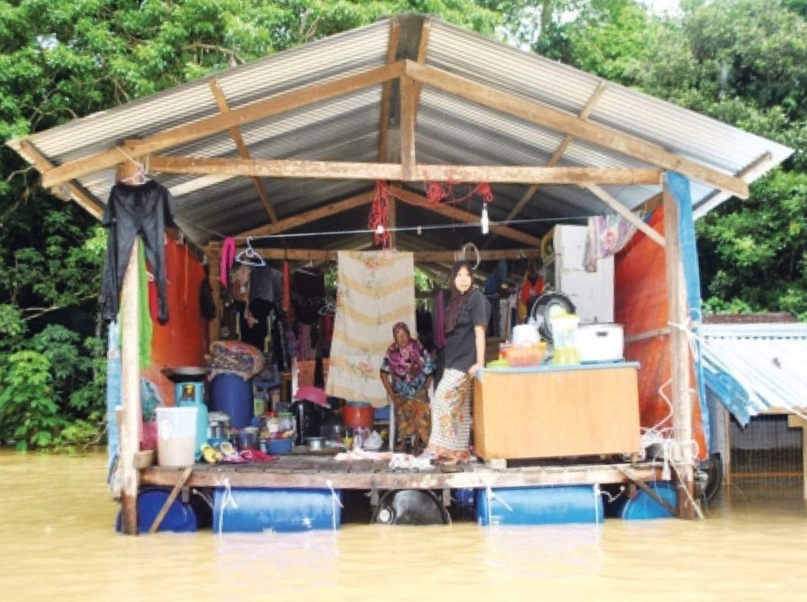
Peranan Komuniti Dalam Pengurangan Risiko Bencana
Disaster Risk Reduction (DRR)
Notes:
Review of literature, however, suggests that DRR initiatives in Malaysia are focused on command and control (top-down approach) i.e. from the federal level to state level and to district level.
Although one-way approach would potentially improve the efficiencies of agencies involved, it may not be able to encourage community resilience due to the lack of understanding in resilient by community-based DRR approach.
With an absence of systematic bottom-up disaster risk reduction initiatives, impacts of resilience to societies could lead to deterioration of livelihood.
So far, various efforts are made to prepare and empower the community mainly through the implementation of management agendas relating to DRR and distribution of necessary assistance before, during and after the disaster.
As the community themselves are the first responders when the disaster strikes, building a resilient community shall become a part of DRR initiatives.
Hence and there is gap in formulation of responsive policy and strategy to promote resilient community towards disaster where the local stakeholder knowledge and aspiration are yet to be taken into consideration.
However, more holistic and inclusive DRR may be achieved through bottom-up approach that emphasizes the empowerment of local actors and participation among local stakeholders in DRR.
Therefore, this study aims at providing new insight into development of community resilience, from policy institutional to community empowerment.

Slide 11
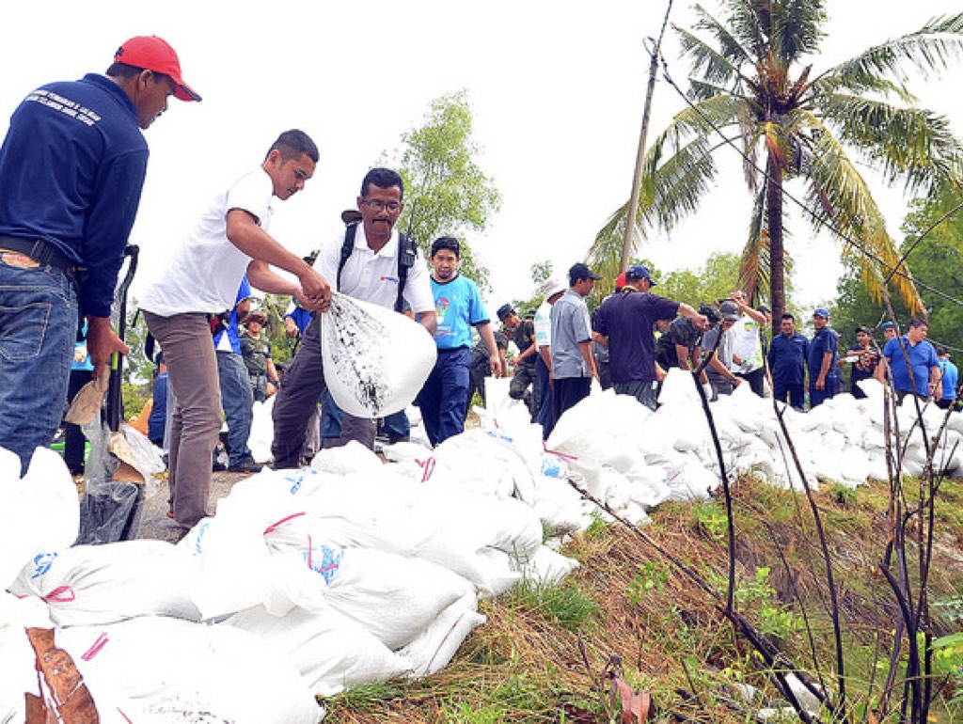
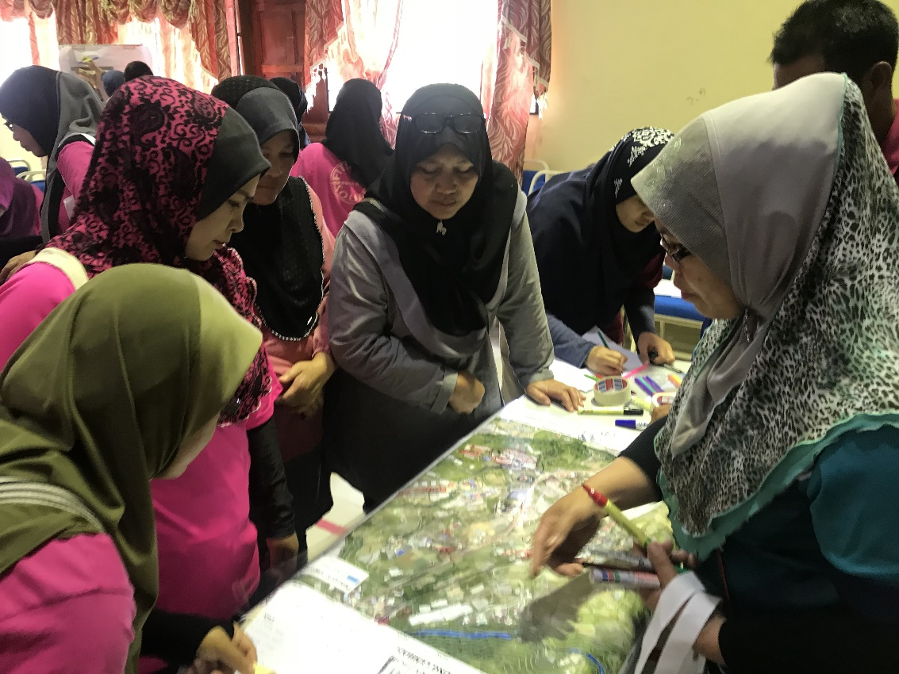
Peranan Komuniti Dalam Pengurangan Risiko Bencana
Disaster Risk Reduction (DRR)
Notes:
Review of literature, however, suggests that DRR initiatives in Malaysia are focused on command and control (top-down approach) i.e. from the federal level to state level and to district level.
Although one-way approach would potentially improve the efficiencies of agencies involved, it may not be able to encourage community resilience due to the lack of understanding in resilient by community-based DRR approach.
With an absence of systematic bottom-up disaster risk reduction initiatives, impacts of resilience to societies could lead to deterioration of livelihood.
So far, various efforts are made to prepare and empower the community mainly through the implementation of management agendas relating to DRR and distribution of necessary assistance before, during and after the disaster.
As the community themselves are the first responders when the disaster strikes, building a resilient community shall become a part of DRR initiatives.
Hence and there is gap in formulation of responsive policy and strategy to promote resilient community towards disaster where the local stakeholder knowledge and aspiration are yet to be taken into consideration.
However, more holistic and inclusive DRR may be achieved through bottom-up approach that emphasizes the empowerment of local actors and participation among local stakeholders in DRR.
Therefore, this study aims at providing new insight into development of community resilience, from policy institutional to community empowerment.

Slide 12
Istilah Yang Berkaitan Dengan Bencana
Disaster Risk Reduction (DRR)
POSITIF | NEGATIF
Selamat | Bahaya
Kebaikan | Keburukan
Meningkatkan | Mengurangkan
Ingat | Lupa
Keupayaan | Keterancaman
Notes:
Review of literature, however, suggests that DRR initiatives in Malaysia are focused on command and control (top-down approach) i.e. from the federal level to state level and to district level.
Although one-way approach would potentially improve the efficiencies of agencies involved, it may not be able to encourage community resilience due to the lack of understanding in resilient by community-based DRR approach.
With an absence of systematic bottom-up disaster risk reduction initiatives, impacts of resilience to societies could lead to deterioration of livelihood.
So far, various efforts are made to prepare and empower the community mainly through the implementation of management agendas relating to DRR and distribution of necessary assistance before, during and after the disaster.
As the community themselves are the first responders when the disaster strikes, building a resilient community shall become a part of DRR initiatives.
Hence and there is gap in formulation of responsive policy and strategy to promote resilient community towards disaster where the local stakeholder knowledge and aspiration are yet to be taken into consideration.
However, more holistic and inclusive DRR may be achieved through bottom-up approach that emphasizes the empowerment of local actors and participation among local stakeholders in DRR.
Therefore, this study aims at providing new insight into development of community resilience, from policy institutional to community empowerment.

Slide 13
Istilah Yang Berkaitan Dengan Bencana
Disaster Risk Reduction (DRR)
Bahaya
X
Keterancaman
= Risiko Bencana
Daya Tahan
Notes:
Review of literature, however, suggests that DRR initiatives in Malaysia are focused on command and control (top-down approach) i.e. from the federal level to state level and to district level.
Although one-way approach would potentially improve the efficiencies of agencies involved, it may not be able to encourage community resilience due to the lack of understanding in resilient by community-based DRR approach.
With an absence of systematic bottom-up disaster risk reduction initiatives, impacts of resilience to societies could lead to deterioration of livelihood.
So far, various efforts are made to prepare and empower the community mainly through the implementation of management agendas relating to DRR and distribution of necessary assistance before, during and after the disaster.
As the community themselves are the first responders when the disaster strikes, building a resilient community shall become a part of DRR initiatives.
Hence and there is gap in formulation of responsive policy and strategy to promote resilient community towards disaster where the local stakeholder knowledge and aspiration are yet to be taken into consideration.
However, more holistic and inclusive DRR may be achieved through bottom-up approach that emphasizes the empowerment of local actors and participation among local stakeholders in DRR.
Therefore, this study aims at providing new insight into development of community resilience, from policy institutional to community empowerment.

Slide 14

Peranan Komuniti Dalam Pengurusan Risiko Bencana
Disaster Risk Reduction (DRR)
Peringkat Pusat
Jawatankuasa Pengurusan Bencana Pusat
NDCC, NADMA
YAB TPM
Sekretariat
Agensi Pengurusan Bencana Negara
Pengarahan
Tempat Kejadian
Ketua Polis Negara / Pengarah KDNKA
Komander
Pelaporan
PDRM
Peringkat Negeri
Jawatankuasa Pengurusan Bencana Negeri
Bilik Gerakan Kerajaan Negeri
Setiausaha
Kerajaan Negeri
Sekretariat
Angkatan Pertahanan Awam Negeri
Pengarahan
Tempat Kejadian
Ketua Polis Negeri
Komander
PDRM
Pelaporan
Peringkat Daerah
Jawatankuasa Pengurusan Bencana Daerah
Bilik Gerakan Pejabat Daerah
Pegawai Daerah
Sekretariat
Angkatan Pertahanan Awam Daerah
Tempat Kejadian
Ketua Polis Daerah
Komander
PDRM
Peringkat Komuniti
Peranan Ketua Kampung; Ketua Komuniti; Pengerusi MPKK, KRT, SRS; Pengerusi Masjid, Gereja, Kuil, Tokong; Pengerusi NGOs dll.
Sumber: Arahan MKN No. 20
Notes:
the disaster risk area in the archipelago area in Peninsular Malaysia, indicated that 44.38% of Peninsular Malaysia was vulnerable area to tsunami, flood and landslide, while the remaining areas are in safe condition from natural disaster.
This shows that almost half the Peninsular Malaysia was exposed to natural disaster risk and requires comprehensive action in addressing the situation.
As well as the enhancement of efforts towards adapting disaster risk reduction approaches and mitigation efforts to enable local communities to cope with the many types of natural disasters they face, can be observed from various sites, ongoing and prospective developments effort globally as well as local government initiatives on DRR.
Among this gap is lack of study for identifying influential factors for community resilient.
With lack of input and information on local community resilient and their capability to raise above adversity, the ‘build back better’ concepts or post disaster and recovery process will take longer. As well as it makes it difficult for local communities to resilient as a whole.
[CLICK] Review of literature also indicated a research gap which highlighted in The National Disaster Management Policy and Mechanism for National Disaster and Relief Management is based on National Security Council (NSC) Directive No. 20 with emphasis on the implementation of operations before, during and after the disaster.
As well as outlining the operational directives or guidelines, but the mitigation and preparedness elements are also taken into account to ensure the community are always resilient to the disaster.
[CLICK] Therefore, a comprehensive research on resilient community is needed to fill the gap as mentioned by the National Security Council (NSC) Directive No. 20 hence providing crucial inputs on the current trend on community resilient.
From this research point of view, works that have been carried out by the NADMA Malaysia starting 2015, mostly focusing on promoting responses phase and hard-measures mitigation activity (top-down approach), rather than the soft-measures activity on DRR (bottom-up approach).
This gap is a strong justification for this research to be carried out to ensure the involvement of every level of stakeholders in disaster management were interconnected. A specific and comprehensive research should foster the understanding of resilient community covered all context.

Slide 15
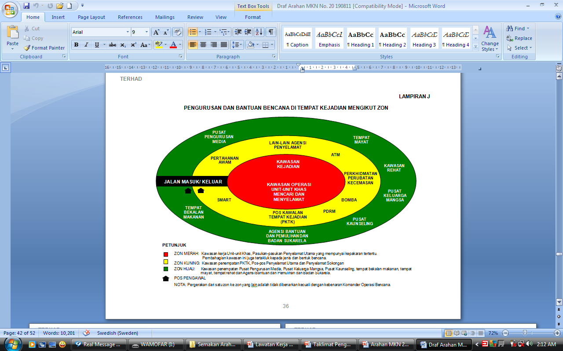
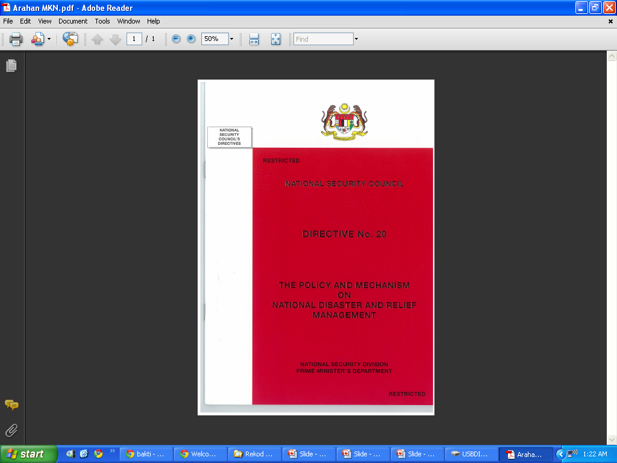
Peranan Komuniti Dalam Pengurusan Risiko Bencana
Arahan MKN No.20 : Mekanisme Pengurusan Bencana
Disaster Risk Reduction (DRR)
PENGURUSAN BENCANA DI TEMPAT KEJADIAN MENGIKUT ZON
Notes:
the disaster risk area in the archipelago area in Peninsular Malaysia, indicated that 44.38% of Peninsular Malaysia was vulnerable area to tsunami, flood and landslide, while the remaining areas are in safe condition from natural disaster.
This shows that almost half the Peninsular Malaysia was exposed to natural disaster risk and requires comprehensive action in addressing the situation.
As well as the enhancement of efforts towards adapting disaster risk reduction approaches and mitigation efforts to enable local communities to cope with the many types of natural disasters they face, can be observed from various sites, ongoing and prospective developments effort globally as well as local government initiatives on DRR.
Among this gap is lack of study for identifying influential factors for community resilient.
With lack of input and information on local community resilient and their capability to raise above adversity, the ‘build back better’ concepts or post disaster and recovery process will take longer. As well as it makes it difficult for local communities to resilient as a whole.
[CLICK] Review of literature also indicated a research gap which highlighted in The National Disaster Management Policy and Mechanism for National Disaster and Relief Management is based on National Security Council (NSC) Directive No. 20 with emphasis on the implementation of operations before, during and after the disaster.
As well as outlining the operational directives or guidelines, but the mitigation and preparedness elements are also taken into account to ensure the community are always resilient to the disaster.
[CLICK] Therefore, a comprehensive research on resilient community is needed to fill the gap as mentioned by the National Security Council (NSC) Directive No. 20 hence providing crucial inputs on the current trend on community resilient.
From this research point of view, works that have been carried out by the NADMA Malaysia starting 2015, mostly focusing on promoting responses phase and hard-measures mitigation activity (top-down approach), rather than the soft-measures activity on DRR (bottom-up approach).
This gap is a strong justification for this research to be carried out to ensure the involvement of every level of stakeholders in disaster management were interconnected. A specific and comprehensive research should foster the understanding of resilient community covered all context.

Slide 16
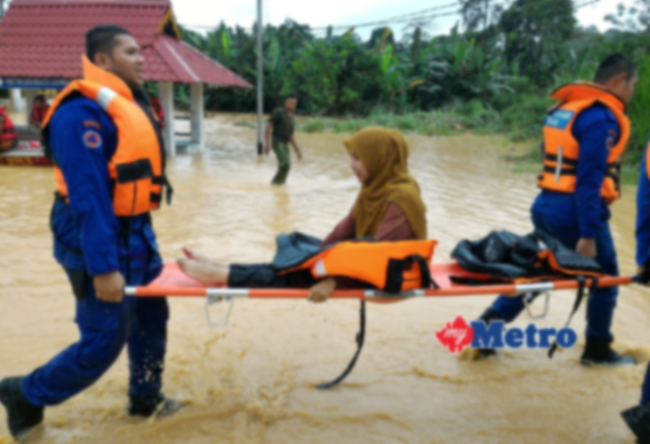





Peranan Komuniti Dalam Pengurusan Risiko Bencana
Disaster Risk Management (DRM)
Badan Pengurusan Bencana
Daerah, Negeri, Nasional
Komuniti
Agensi / Penyelamat
Top Bottom
Top Bottom
Bottom Up
Bottom Up
PERANAN?
Pengumpul Maklumat
Tindakbalas Maklumat
Sardi et al. (2021)
Notes:
Review of literature, however, suggests that DRR initiatives in Malaysia are focused on command and control (top-down approach) i.e. from the federal level to state level and to district level.
Although one-way approach would potentially improve the efficiencies of agencies involved, it may not be able to encourage community resilience due to the lack of understanding in resilient by community-based DRR approach.
With an absence of systematic bottom-up disaster risk reduction initiatives, impacts of resilience to societies could lead to deterioration of livelihood.
So far, various efforts are made to prepare and empower the community mainly through the implementation of management agendas relating to DRR and distribution of necessary assistance before, during and after the disaster.
As the community themselves are the first responders when the disaster strikes, building a resilient community shall become a part of DRR initiatives.
Hence and there is gap in formulation of responsive policy and strategy to promote resilient community towards disaster where the local stakeholder knowledge and aspiration are yet to be taken into consideration.
However, more holistic and inclusive DRR may be achieved through bottom-up approach that emphasizes the empowerment of local actors and participation among local stakeholders in DRR.
Therefore, this study aims at providing new insight into development of community resilience, from policy institutional to community empowerment.

Slide 17
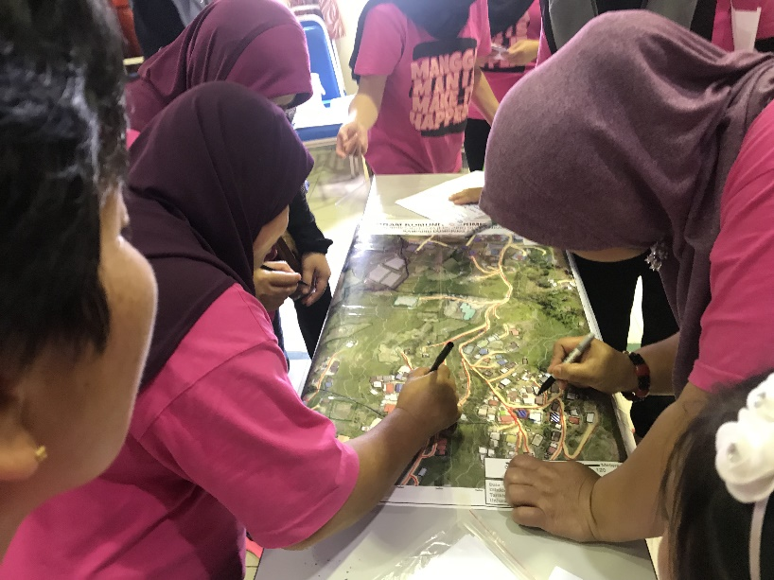
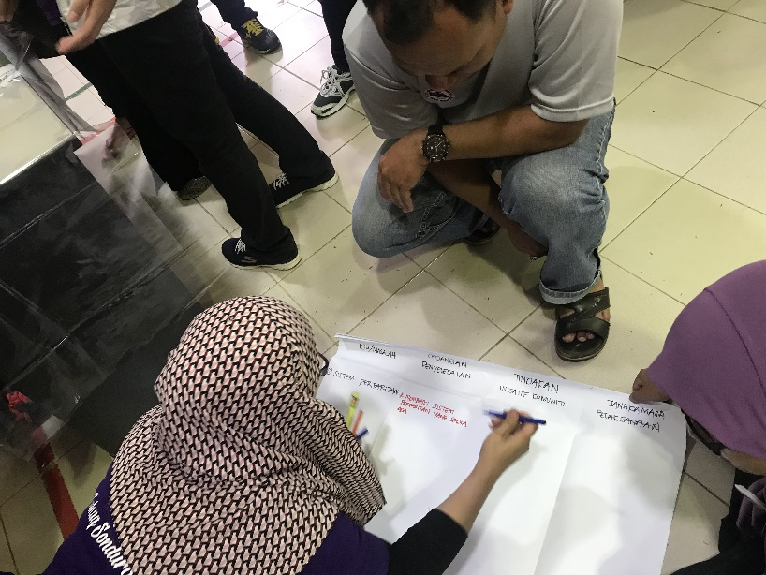
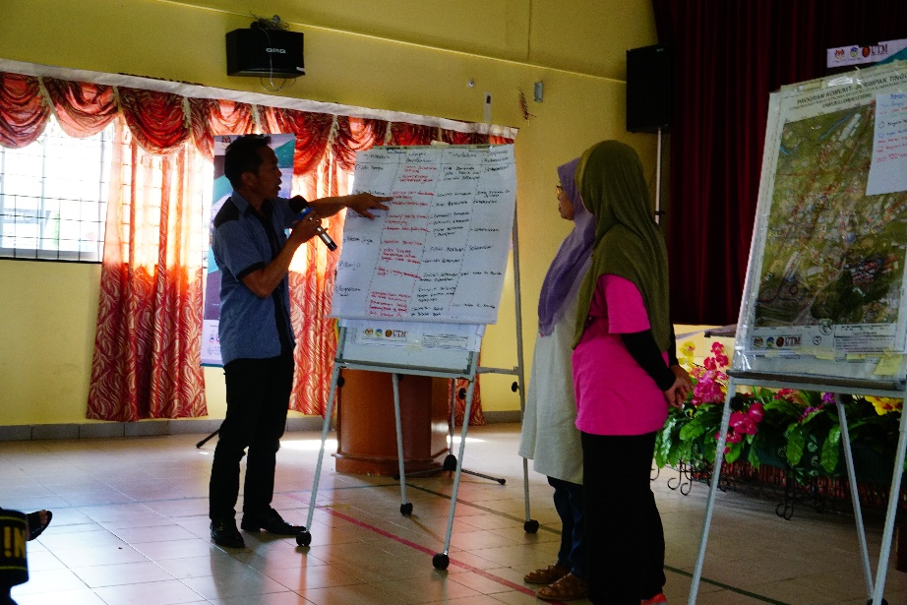
Pengurusan Risiko Bencana Berasaskan Komuniti
Community-Based Disaster Risk Management (CBDRM)
Masyarakat yang merancang langkah-langkah pengurangan dan pengurusan risiko bencana
HiCBDRR Kundasang 2018
Notes:
Review of literature, however, suggests that DRR initiatives in Malaysia are focused on command and control (top-down approach) i.e. from the federal level to state level and to district level.
Although one-way approach would potentially improve the efficiencies of agencies involved, it may not be able to encourage community resilience due to the lack of understanding in resilient by community-based DRR approach.
With an absence of systematic bottom-up disaster risk reduction initiatives, impacts of resilience to societies could lead to deterioration of livelihood.
So far, various efforts are made to prepare and empower the community mainly through the implementation of management agendas relating to DRR and distribution of necessary assistance before, during and after the disaster.
As the community themselves are the first responders when the disaster strikes, building a resilient community shall become a part of DRR initiatives.
Hence and there is gap in formulation of responsive policy and strategy to promote resilient community towards disaster where the local stakeholder knowledge and aspiration are yet to be taken into consideration.
However, more holistic and inclusive DRR may be achieved through bottom-up approach that emphasizes the empowerment of local actors and participation among local stakeholders in DRR.
Therefore, this study aims at providing new insight into development of community resilience, from policy institutional to community empowerment.

Slide 18
Kenapa Perlu Komuniti Dilibatkan???
Community-Based Disaster Risk Management (CBDRM)
Komuniti mempunyai pengetahuan sedia ada (pengetahuan tradisi dan setempat) tentang keterancaman dan keupayaan mereka dan kawasan mereka sendiri.
Komuniti setempat akan bertindak segera sekiranya berlaku bencana.
Bertanggungjawab untuk menjadi responden pertama.
Notes:
Review of literature, however, suggests that DRR initiatives in Malaysia are focused on command and control (top-down approach) i.e. from the federal level to state level and to district level.
Although one-way approach would potentially improve the efficiencies of agencies involved, it may not be able to encourage community resilience due to the lack of understanding in resilient by community-based DRR approach.
With an absence of systematic bottom-up disaster risk reduction initiatives, impacts of resilience to societies could lead to deterioration of livelihood.
So far, various efforts are made to prepare and empower the community mainly through the implementation of management agendas relating to DRR and distribution of necessary assistance before, during and after the disaster.
As the community themselves are the first responders when the disaster strikes, building a resilient community shall become a part of DRR initiatives.
Hence and there is gap in formulation of responsive policy and strategy to promote resilient community towards disaster where the local stakeholder knowledge and aspiration are yet to be taken into consideration.
However, more holistic and inclusive DRR may be achieved through bottom-up approach that emphasizes the empowerment of local actors and participation among local stakeholders in DRR.
Therefore, this study aims at providing new insight into development of community resilience, from policy institutional to community empowerment.

Slide 19
Objektif Penglibatan Komuniti
Community-Based Disaster Risk Management (CBDRM)
Supaya komuniti tidak mengalami kesan yang teruk akibat bencana
Supaya komuniti masih terus berkeupayaan untuk melalui saat-saat kecemasan semasa bencana serta mampu pulih dengan kadar segera
Notes:
Review of literature, however, suggests that DRR initiatives in Malaysia are focused on command and control (top-down approach) i.e. from the federal level to state level and to district level.
Although one-way approach would potentially improve the efficiencies of agencies involved, it may not be able to encourage community resilience due to the lack of understanding in resilient by community-based DRR approach.
With an absence of systematic bottom-up disaster risk reduction initiatives, impacts of resilience to societies could lead to deterioration of livelihood.
So far, various efforts are made to prepare and empower the community mainly through the implementation of management agendas relating to DRR and distribution of necessary assistance before, during and after the disaster.
As the community themselves are the first responders when the disaster strikes, building a resilient community shall become a part of DRR initiatives.
Hence and there is gap in formulation of responsive policy and strategy to promote resilient community towards disaster where the local stakeholder knowledge and aspiration are yet to be taken into consideration.
However, more holistic and inclusive DRR may be achieved through bottom-up approach that emphasizes the empowerment of local actors and participation among local stakeholders in DRR.
Therefore, this study aims at providing new insight into development of community resilience, from policy institutional to community empowerment.

Slide 20
Bagaimana Komuniti Dapat Turut Serta???
Community-Based Disaster Risk Management (CBDRM)
Peningkatan keupayaan kawasan dan komuniti setempat melalui peningkatan faktor-faktor:
Keterhubungan – pemegang taruh (komuniti, kerajaan setempat, NGO dan lain-lain);
Perancangan dan langkah-langkah;
Sumber daya dan keperluan.
Pengurangan risiko dan keterancaman melalui pemahaman risiko serta akibatnya di setiap bahagian komuniti.
Notes:
Review of literature, however, suggests that DRR initiatives in Malaysia are focused on command and control (top-down approach) i.e. from the federal level to state level and to district level.
Although one-way approach would potentially improve the efficiencies of agencies involved, it may not be able to encourage community resilience due to the lack of understanding in resilient by community-based DRR approach.
With an absence of systematic bottom-up disaster risk reduction initiatives, impacts of resilience to societies could lead to deterioration of livelihood.
So far, various efforts are made to prepare and empower the community mainly through the implementation of management agendas relating to DRR and distribution of necessary assistance before, during and after the disaster.
As the community themselves are the first responders when the disaster strikes, building a resilient community shall become a part of DRR initiatives.
Hence and there is gap in formulation of responsive policy and strategy to promote resilient community towards disaster where the local stakeholder knowledge and aspiration are yet to be taken into consideration.
However, more holistic and inclusive DRR may be achieved through bottom-up approach that emphasizes the empowerment of local actors and participation among local stakeholders in DRR.
Therefore, this study aims at providing new insight into development of community resilience, from policy institutional to community empowerment.

Slide 21
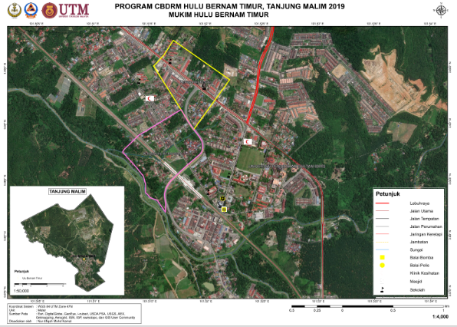
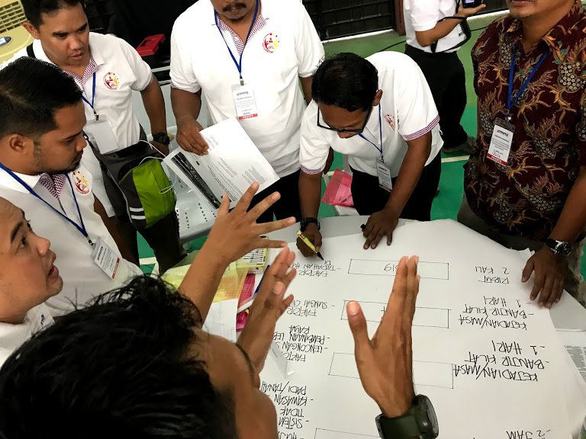
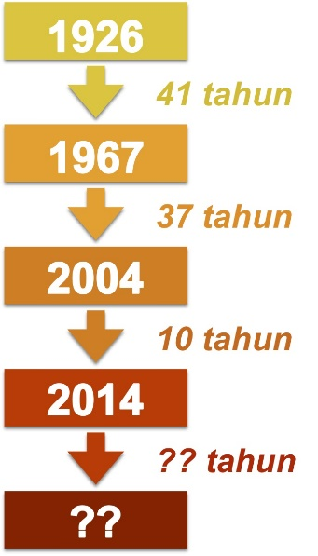
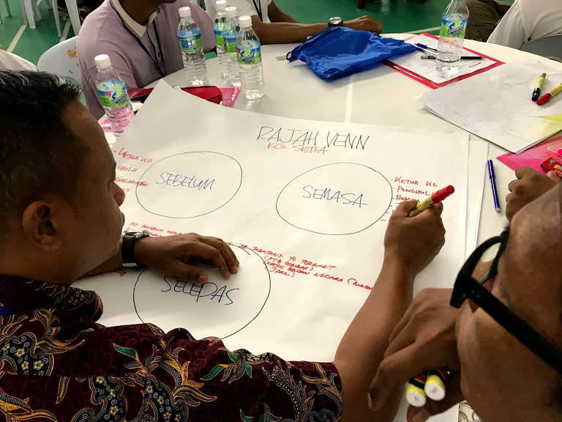
Aktiviti : Garis Waktu Bencana & Gambarajah Venn
Community-Based Disaster Risk Management (CBDRM)
Sebelum
Semasa
Selepas
Tanjung Malim
Siapa yang pernah memberikan bantuan?
Sejarah Bencana Setempat
CBDRM Kundang 2019
CBDRM Kundang 2019
Notes:
Review of literature, however, suggests that DRR initiatives in Malaysia are focused on command and control (top-down approach) i.e. from the federal level to state level and to district level.
Although one-way approach would potentially improve the efficiencies of agencies involved, it may not be able to encourage community resilience due to the lack of understanding in resilient by community-based DRR approach.
With an absence of systematic bottom-up disaster risk reduction initiatives, impacts of resilience to societies could lead to deterioration of livelihood.
So far, various efforts are made to prepare and empower the community mainly through the implementation of management agendas relating to DRR and distribution of necessary assistance before, during and after the disaster.
As the community themselves are the first responders when the disaster strikes, building a resilient community shall become a part of DRR initiatives.
Hence and there is gap in formulation of responsive policy and strategy to promote resilient community towards disaster where the local stakeholder knowledge and aspiration are yet to be taken into consideration.
However, more holistic and inclusive DRR may be achieved through bottom-up approach that emphasizes the empowerment of local actors and participation among local stakeholders in DRR.
Therefore, this study aims at providing new insight into development of community resilience, from policy institutional to community empowerment.

Slide 22
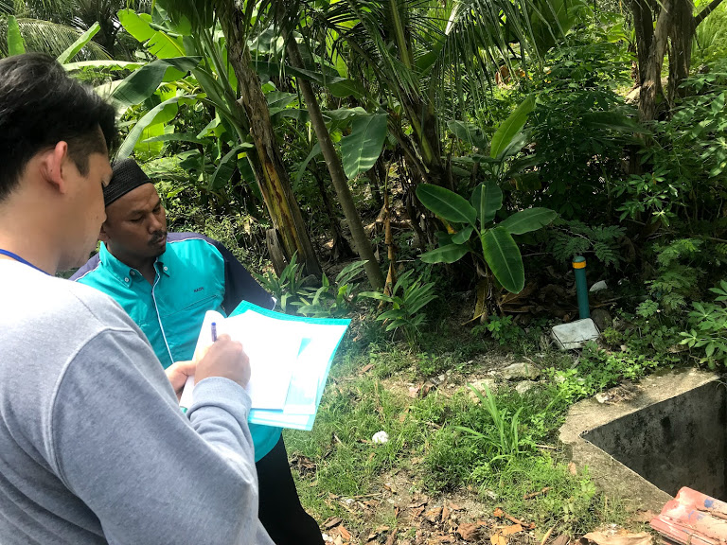
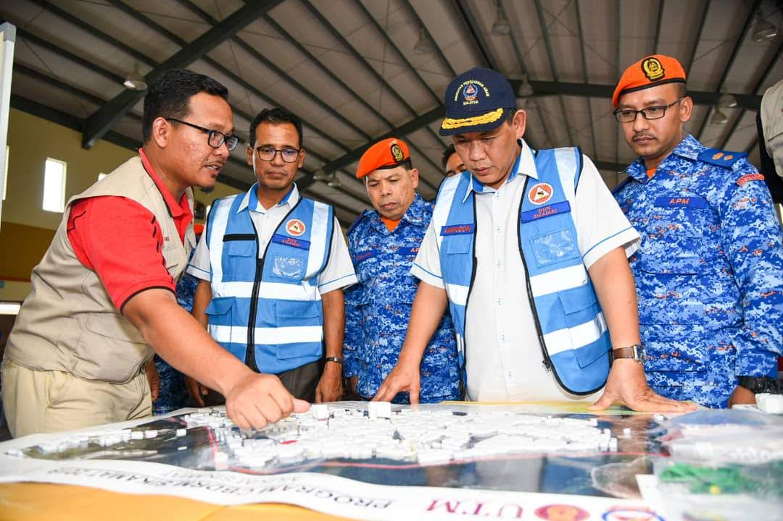
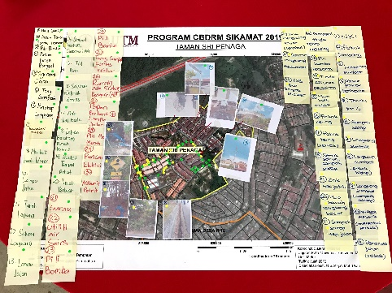
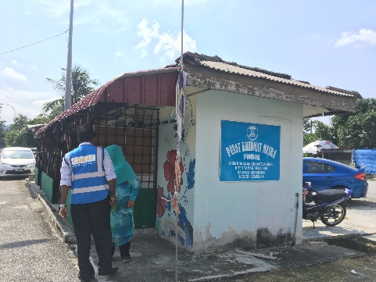
Aktiviti : Jenguk Kampung
Community-Based Disaster Risk Management (CBDRM)
Adaptasi dari aktiviti Town Watching berdasarkan konsep perancangan bandar oleh masyarakat yang diperkenalkan oleh perancang bandar Jepun di tahun 1970an, bagi memahami:
Konsep pengurangan risiko bencana;
Faktor sejarah, alam sekitar dan isu-isu setempat;
Melakukan proses pemetaan kawasan setempat;
Menyiapkan rangka kerja dan perancangan persiapan bencana
CBDRM Kundang 2019
CBDRM Sikamat 2019
CBDRM Sikamat 2019

Slide 23
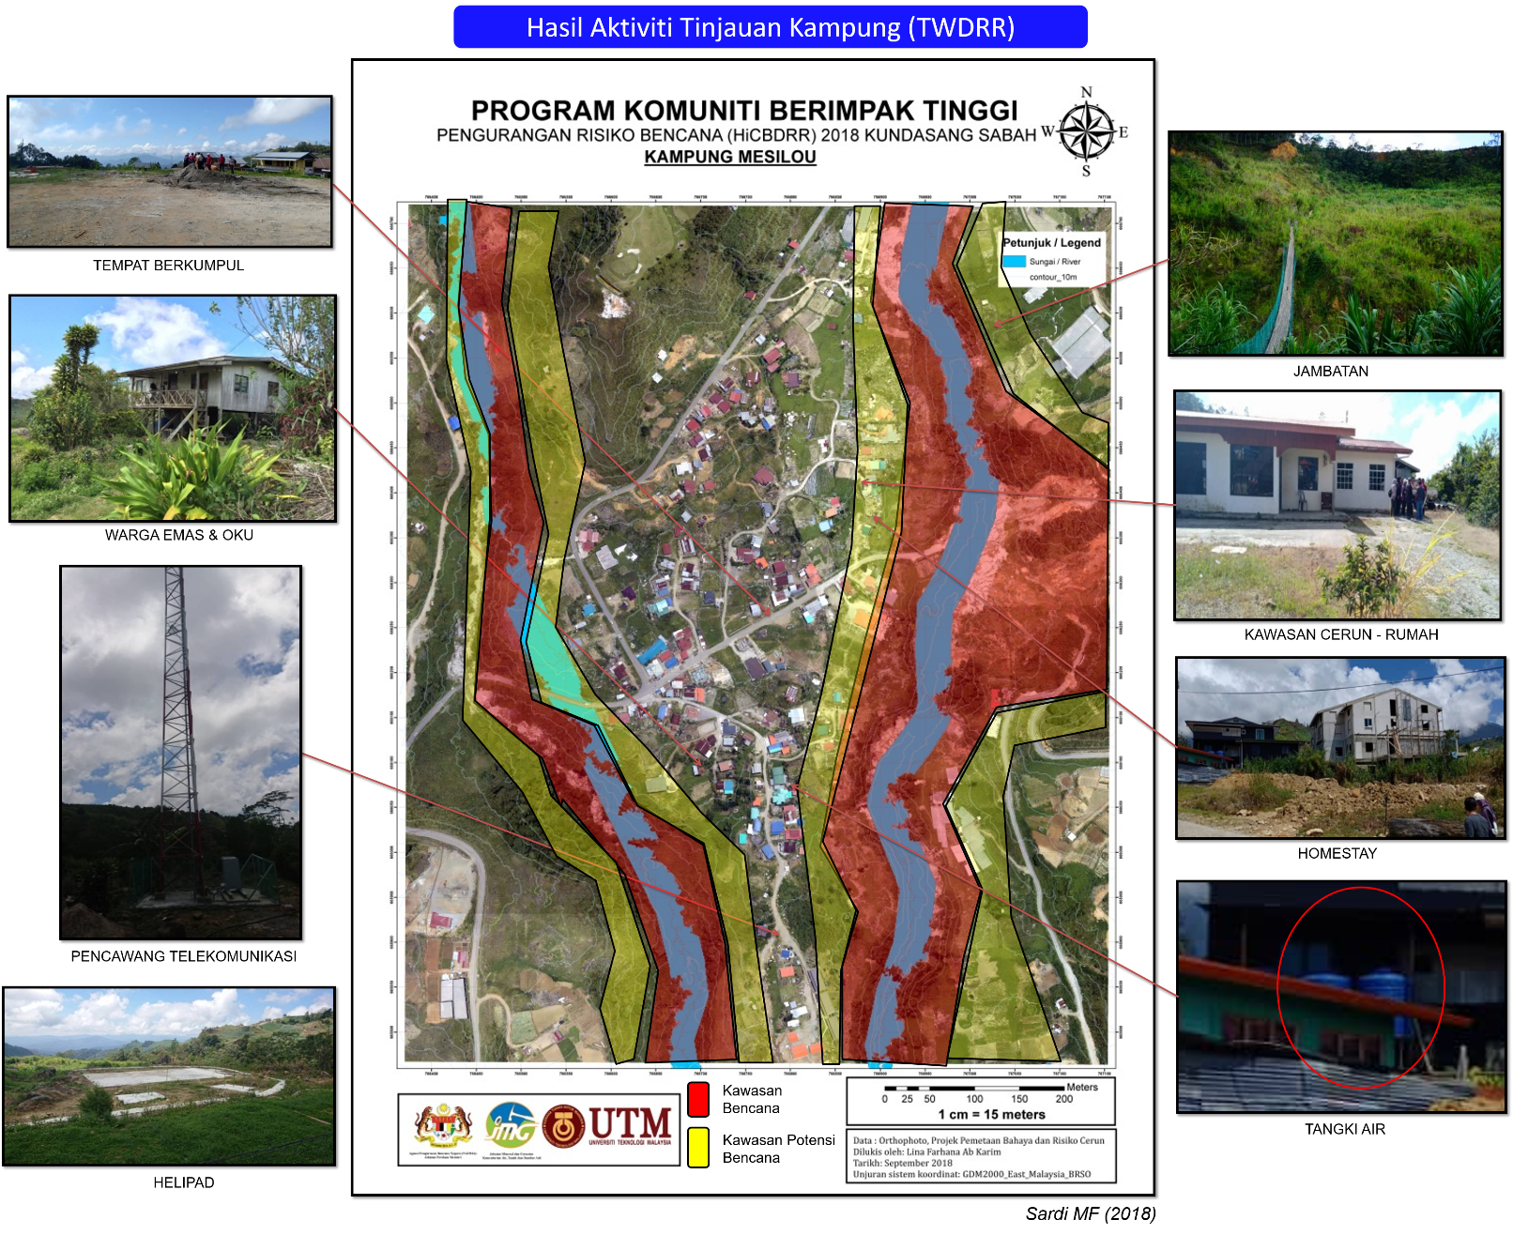
Aktiviti : Jenguk Kampung
Community-Based Disaster Risk Management (CBDRM)
HiCBDRR Kundasang 2018

Slide 24
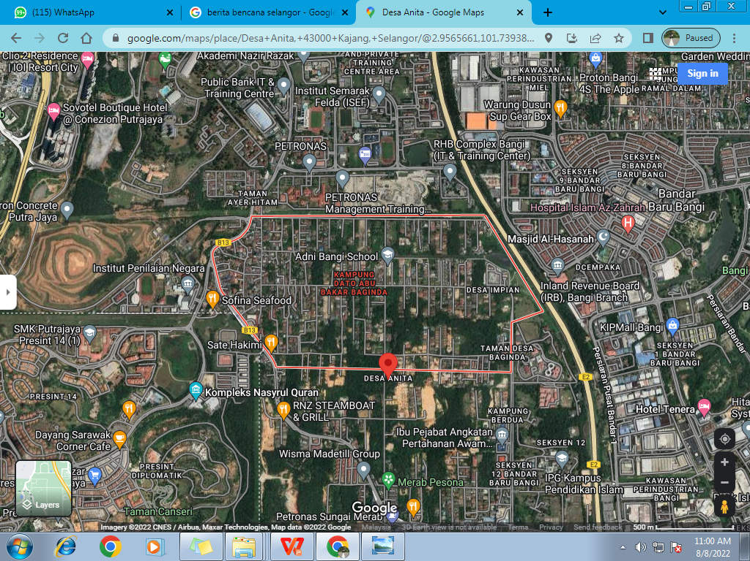
Sumber Peta Satelit
Community-Based Disaster Risk Management (CBDRM)
KG DATO ABU BAKAR BAGINDA

Slide 25
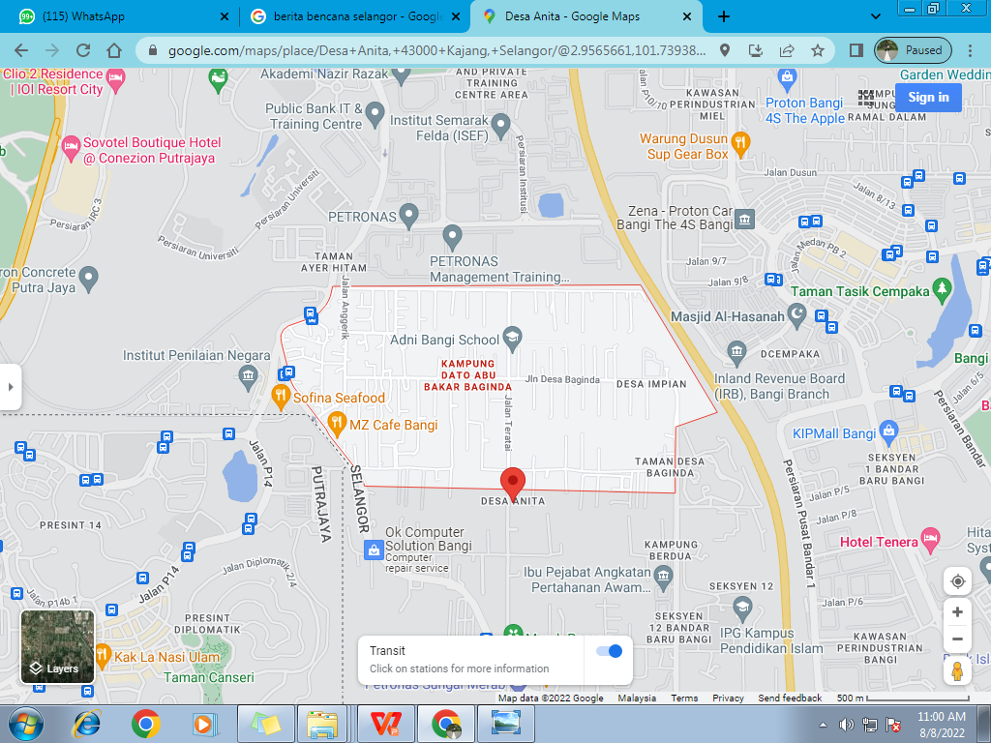
Sumber Peta Satelit
Community-Based Disaster Risk Management (CBDRM)
KAMPUNG DATO ABU BAKAR BAGINDA
wikimapia.org

Slide 26
Aktiviti : Jenguk Kampung
Community-Based Disaster Risk Management (CBDRM)
PERBINCANGAN DALAM KUMPULAN
Isu / Masalah | Cadangan Penyelesaian | Tindakan / Inisiatif Komuniti | Jangkamasa Pelaksanaan
Tiada siren awal kecemasan / bencana | Mewujudkan system amaran awal | -Buat permohonan melalui MPKK - Guna pembesar suara surau / masjid | Secepat mungkin berterusan
Rumah terbiar | Musnahkan / Roboh | Gotong royong membersihkan | 6 bulan sekali
Signboard amaran | Tambah Bilangan | JK Keselamatan | 12 bulan
Parit Tersumbat | Menyelenggara saliran | Memantau dan membersihkan | 3 bulan sekali
CONTOH

Slide 27
Way Forward
CBDRM ZON WILAYAH TENGAH
Pemahaman konsep Pengurangan dan Pengurusan Risiko Bencana (DRR dan DRM) oleh komuniti boleh dimulakan dengan:
Pengenalan konsep dan amalan DRR
Perkongsian pengalaman komuniti setempat
Pemetaan risiko bencana (aktiviti Jenguk Kampung)
Pengadaan pelan tindakan dan penubuhan jawatankuasa pengurusan bencana peringkat komuniti

Slide 28

Kolaborasi Bersama:
THANK YOU
Terima Kasih

Slide 29
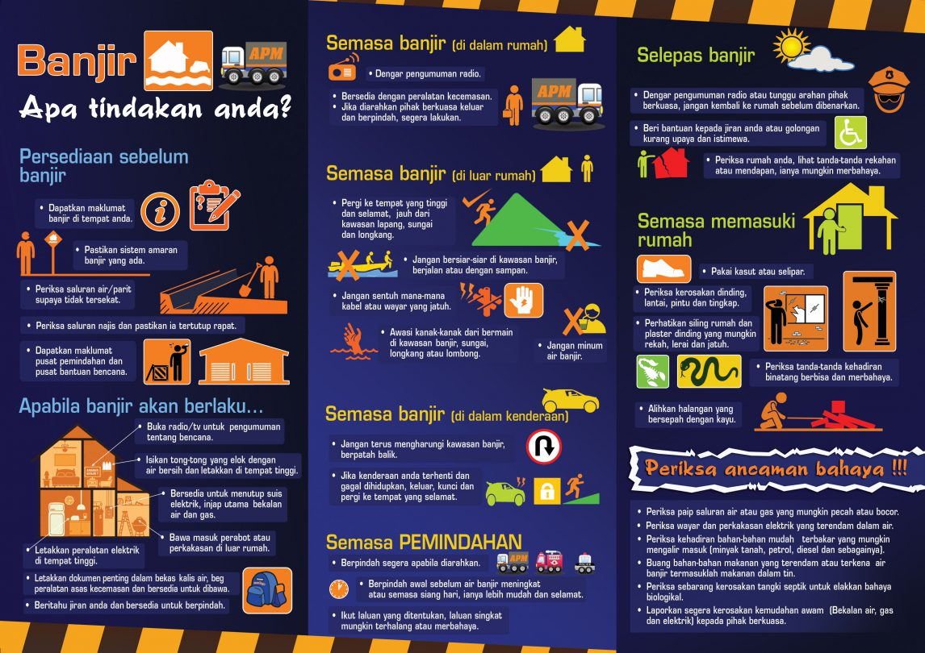
Notes:
Review of literature, however, suggests that DRR initiatives in Malaysia are focused on command and control (top-down approach) i.e. from the federal level to state level and to district level.
Although one-way approach would potentially improve the efficiencies of agencies involved, it may not be able to encourage community resilience due to the lack of understanding in resilient by community-based DRR approach.
With an absence of systematic bottom-up disaster risk reduction initiatives, impacts of resilience to societies could lead to deterioration of livelihood.
So far, various efforts are made to prepare and empower the community mainly through the implementation of management agendas relating to DRR and distribution of necessary assistance before, during and after the disaster.
As the community themselves are the first responders when the disaster strikes, building a resilient community shall become a part of DRR initiatives.
Hence and there is gap in formulation of responsive policy and strategy to promote resilient community towards disaster where the local stakeholder knowledge and aspiration are yet to be taken into consideration.
However, more holistic and inclusive DRR may be achieved through bottom-up approach that emphasizes the empowerment of local actors and participation among local stakeholders in DRR.
Therefore, this study aims at providing new insight into development of community resilience, from policy institutional to community empowerment.

Slide 30







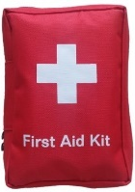






BEG KECEM SAN BENCANA
CBDRM ZON WILAYAH TENGAH
2
READY GO Bag
Wisel
Dokumen Penting
Lampu Suluh
Wang Tunai
Kit Perubatan Kecemasan
Makanan Tin /
Sedia Untuk Dimakan
Powerbank
Tisu Basah
Tuala
Air Mineral
Kit Kebersihan
Info lanjut sila ke → http://www.civildefence.gov.my

Slide 31
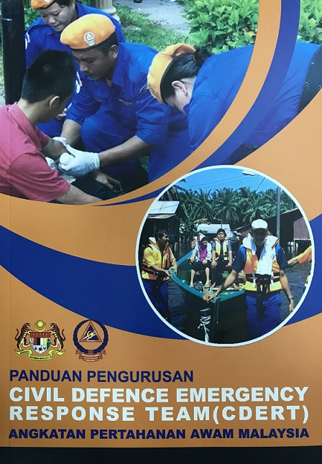
PENILAIAN
CBDRM ZON WILAYAH TENGAH
Membuat penilaian pelaksanaan Aktiviti Jenguk Kampung kepada kumpulan sasar:
Adakah ianya mencapai objektif?
Kumpulan sasar yang sesuai?
Bahan dan informasi yang disampaikan mencukupi?
Adakah pemudahcara bersesuaian?
Membuat analisa ringkas untuk perancangan akan datang berdasarkan output yang diterima.
Mengadakan Pelan Tindakan Bencana Berasaskan Komuniti

